Slide 1
DTH Customer Churn Prediction
Mohamed Rifaz Ali
University of Great lakes

Slide 2
Business Problem Understanding
WHAT WE ARE TRYING TO SOLVE
A Direct to Home (DTH) provider is facing a lot of competition in the current market and it has become a challenge to retain the existing customers in the current situation. As customers switch to alternate provider due to various reasons like lower cost, service offerings, marketing promotions by competitors, it is just a ‘one click away’ to move to other vendors.
We are provided with the ‘account’ information for the last 12 months, one account can have multiple customers. So, by losing one account the company might be losing more than one customer. Hence, the company wants to develop a model through which they can do churn prediction of the accounts and provide segmented offers to the potential churners.

Slide 3
Ratio of non-churn to churn on the provided data is 83% to 17%.
1.25% of missing values in the dataset & Data anomalies to be treated.
Offering a lot of free subsidies should not make loss to the organization.
Identify the potential accounts early who may voluntarily churn and provide them
discounts & combo offers will help the organization to retain those customers and
reduce revenue loss.
Leverage social media to enhance Telecom customer experience. It will improve our
business implicitly at no cost.
To predict the accounts who is likely to leave from the existing service provider in near
future, so then we offer them incentives to stay, can offer huge savings to a business.
Predict the churn accounts with high accuracy in advance.
Choose the best model based on performance and lowest cost misclassification.
With the provided data, recommend products strategies to the business based on
the analysis that will help retain the customers .
CONSTRAINTS
SCOPE
OBJECTIVES

Slide 4
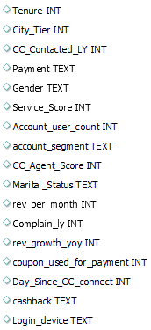
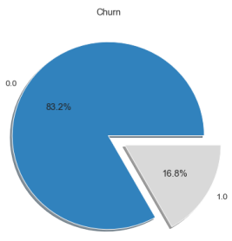
DATA DESCRIPTION
Data consists of 11260 accounts.
Independent variables: 5 Categorical & 12 Continuous variables.
Target variable: Churn
Churn Rate (baseline) is 17%.
23% ‘raised complaint’ in last 12 months, 32% of them are churned and 68% not churned, so it is not the primary cause to churn.
Accounts using ‘COD’ as the payment have the high churn rate(25%).
‘Tenure/Day_Since_CC_connect’ is correlated(-ve) with the Churn variable.
‘Coupon used for payment’ variable outlier is 12% and ‘cashback’ is 8%.
Data is partitioned into 70% for training & 30% for testing.

Slide 5
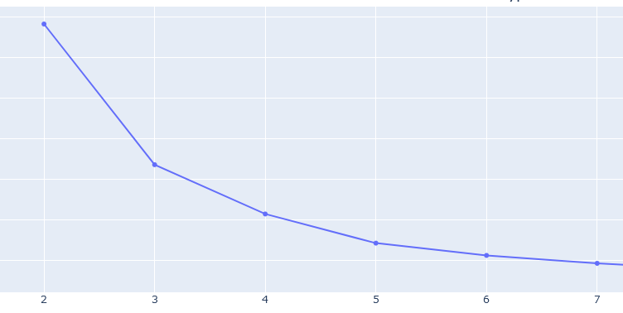
Modelling Approach Used & Why
K-Prototypes is a lesser known sibling but offers an advantage of working with mixed data types. It measures distance between numerical features using Euclidean distance (like K-means) but also measure the distance between categorical features using the number of matching categories
Using the Elbow method, K=3 seems most efficient.
CLUSTERING

Slide 6
RESULTS & INFERENCES FROM CLUSTERING
Segment 1 – Detractors
Customers who are unlikely to remain or encourage others to return—and even worse—may discourage others from trying to trust the business or brand.
Segment 2 – Passives
Customers who have positive/constructive feelings towards the brand but are not expressing a need to change.
Segment 3 – Promoters
Customers who are typically the brand's ambassadors, enhancing a brand's reputation and/publicity and referrals flow.
Features | Segment 1 | Segment 2 | Segment 3
Tenure | 7 | 11 | 18
CC Contacted LY | 17 | 18 | 18
rev_per_month | 5 | 6 | 6
rev_growth_yoy | 16 | 16 | 16
coupon used for payment | 1 | 2 | 2
Day Since CC Connect | 3 | 5 | 6
Cashback | 143.92 | 187.3 | 262.25
City Tier | 1 | 1 | 1
Payment | Debit Card | Debit Card | Debit Card
Marital status | Male | Male | Male
Service Score | 3 | 3 | 3
account segment | Regular Plus | Super | Super Plus
CC Agent Score | 3 | 3 | 3
Marital Status | Married | Married | Married
Complain LY | No | No | No
Login Device | Mobile | Mobile | Mobile
Account User Count | 3 | 4 | 4
Churn | 0 | 0 | 0

Slide 7
CLASSIFICATION MODELS SUMMARY
For our DTH account churn prediction case, we are less care about the ‘account not churned’ and more care about the ‘account churned’. How many of the actual accounts are churning that we were able to predict correctly with our model. So, we aim for high ‘recall’ in this case.
Multiple models within each type are built and Optimal model is selected for comparison
Logistic Regression/LDA: Very Poor metrics scores.
KNN: 7 variables are selected as significant variables with the optimum K value as 2.
ANN: Only Tenure has been selected as the significant variable.
CART: 11 variables are selected as significant variables.
Random Forest: 12 variables are selected as significant variables.
Gradient Boosting: 7 variables are selected as significant variables.

Slide 8
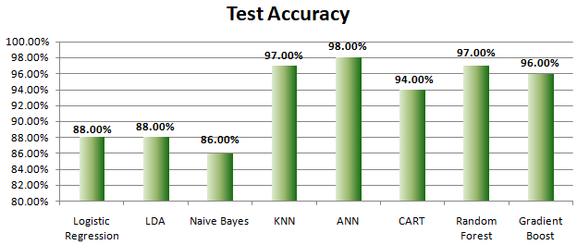
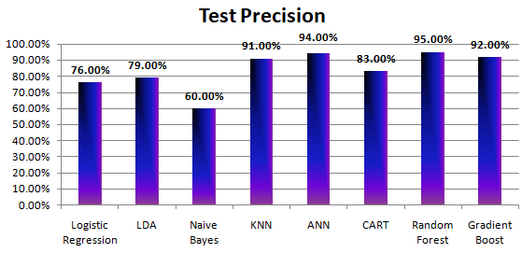
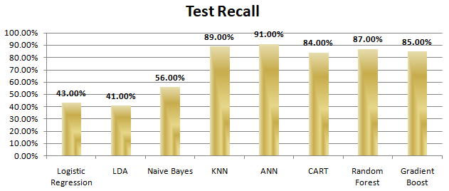
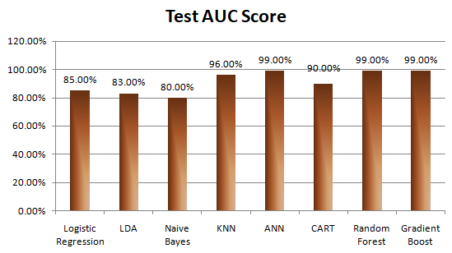
MODEL COMPARISON & ANALYSIS

Slide 9
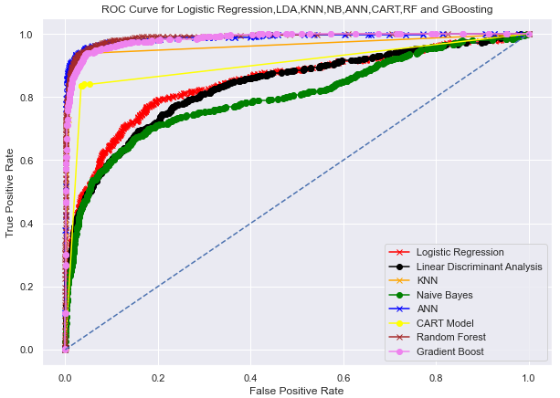
MODEL EVALUATION
INFERENCES FROM METRICS
Accuracy/Recall/Precision scores are good for KNN,
ANN, Random Forest & Gradient Boosting Models.
Model performance is 99% for ANN, RF & GB,
better than KNN.
Random Forest is easier to train & test, whereas
ANN & GB models are computationally expensive.
Random Forest does not require scaling, whereas
KNN & ANN require the records in common scale &
prone to outliers.
RF explains which features are more important.
RF model utilized most of the variables to make a
account churn prediction which is lagging in KNN &
ANN models.
RF can automatically balance data sets when a
class is more infrequent than other classes in the
dataset.

Slide 10
CUTOFF THRESHOLD TECHNIQUE & INFERENCES
Model Name | Test Recall | Test Threshold Recall | Test F1 Score | Test F1 Threshold | Test AUC Score | Test AUC Threshold
KNN | 89.00% |  | 90.00% |  | 96.00%
ANN | 91.00% |  | 92.00% |  | 99.00%
Random Forest | 87.00% | 94.00% | 90.00% | 89.00% | 99.00% | 95.00%
Gradient Boost | 85.00% | 92.00% | 88.00% | 87.00% | 99.00% | 94.00%
When we run the Random Forest model with the cutoff value of 0.3 and a slight
compromise on the F1 score of 4%, have attained an increase in the ‘recall’ score
of about 7% (87% to 94%). This is the best score compared to any other models.
The model performance is good with 95%.
The cost implications is always there when we have more churners.

Slide 11
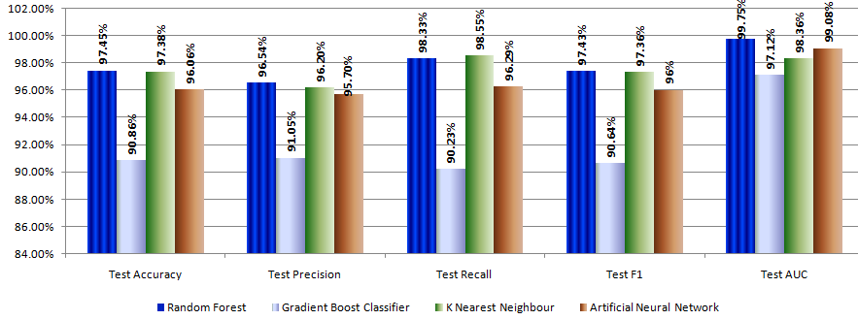
SMOTE TECHNIQUE & INFERENCES
When we have balanced set of classes, Random Forest is the optimum model in all aspects. Model performance is close to 100% even.

Slide 12
Insights from Analysis
Churn is observed for the accounts contacted the customer care frequently
during the 1st 2 years in the Tenure.
High Churn is observed for the account types Regular and HNI even the account
stays in the tenure more than 5 years.
32% of the churn of accounts occurred when the complaint has been raised.
25% of the churn of accounts occurred when the payment is COD, so implicitly
indicate that customers are not treated well when step into the store.
Even the account counts of Regular Plus and Super is almost similar, we observed
that 27% of the churn occurred with the account type as Regular Plus but when
they switch onto the next level (i.e., Super), the churn rate is reduced to 10%.
Offers and plans to be revisited between these two account types.

Slide 13
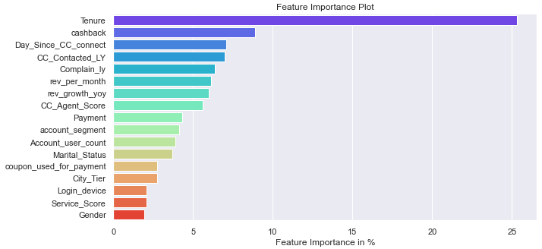
INSIGHTS FROM RANDOM FOREST MODEL
RF makes the prediction utilizing ‘Tenure’ variable with ~25% & cumulative
consideration of all the other continuous and categorical variables, which indicates
that it work well in the production data.
Tenure, cashback, Day_Since_CC_connect, CC_Contacted_LY, Complain_ly,
revenue, CC_Agent_score are most important features of churning.

Slide 14
Recommendations
Improve the services in the store when customers approach to pay(COD). Set up a
token-based system to pay their monthly charges. Provide them a feedback form to get
the ratings, & take appropriate actions.
Keep your new customers happy with regular follow-ups (Quarterly once at least for 2
years) to get their feedback about the services, and whether the chosen plan meets
their expectations or not; because, the more churn occurred during the first 2 years in
the contract.
Since the Super account type is just the next level to Regular Plus account type, the
churn rate has come down to 10% from 27%. Offers and plans need to be revisited
between these two account types.

Slide 15
Recommendations
Don’t provide more offers to the Regular & HNI account types; because they are ready
to cancel the service regardless of the tenure.
The churn rate for the accounts that raised the complaint is 32%, whereas when they
have not risen it is just 11%. So, inform the customer service to give more importance
to the cases that have raised the complaint, keeping your customer a service issue to a
minimum is the key.
The times the customers of the account contacted customer care are high then the
churn rate is also increased. Customer service has always affected the customer
satisfaction. From issues reaching the call centers to the actual resolution of the
customer’s problem. Take necessary action to improve the customer service
experience.

Slide 16
THANK YOU!

